Slide 1
Short history of statistical genetics

Slide 2
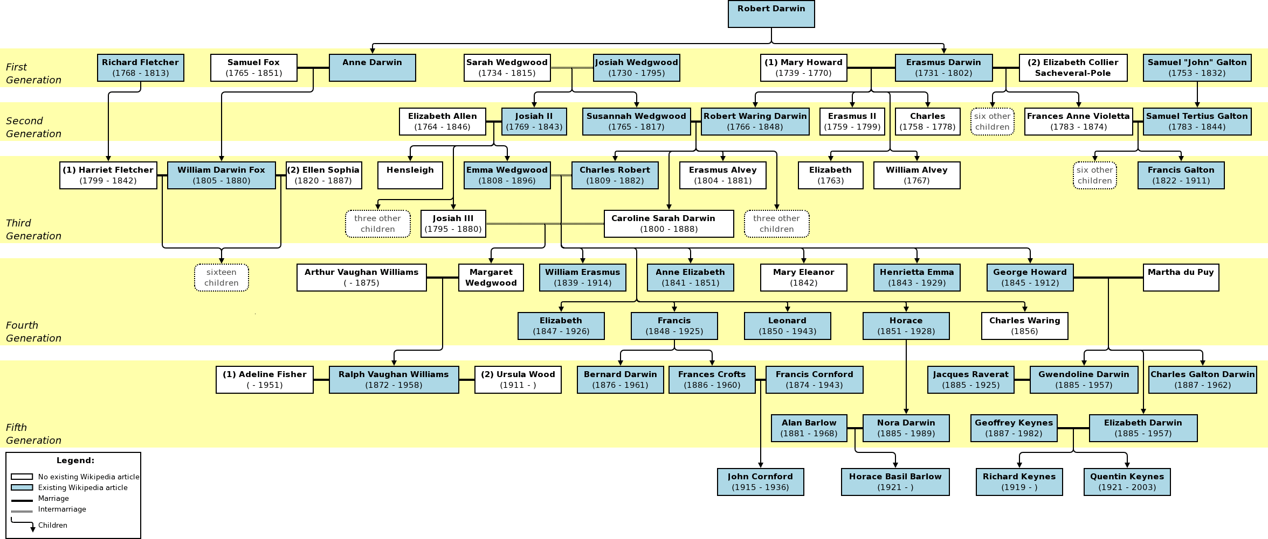
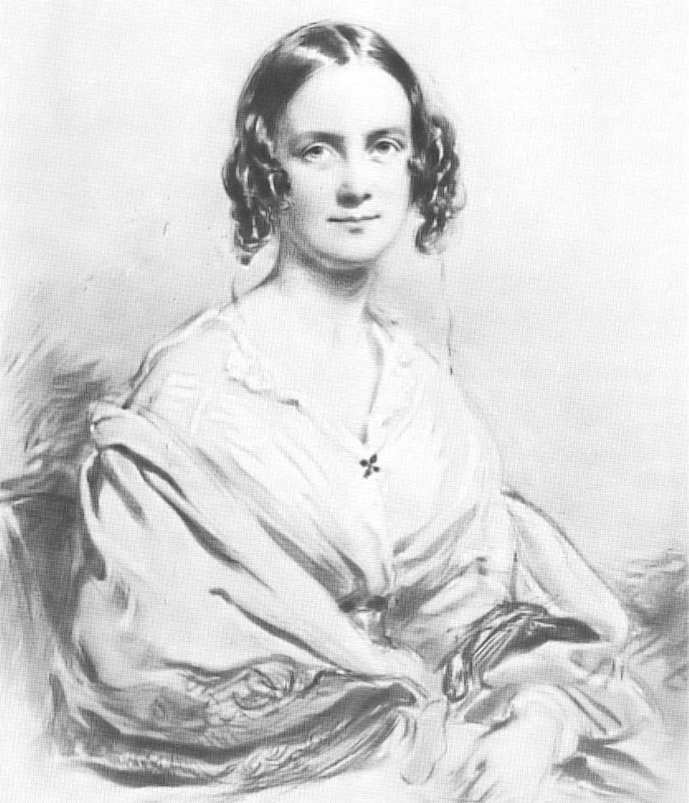
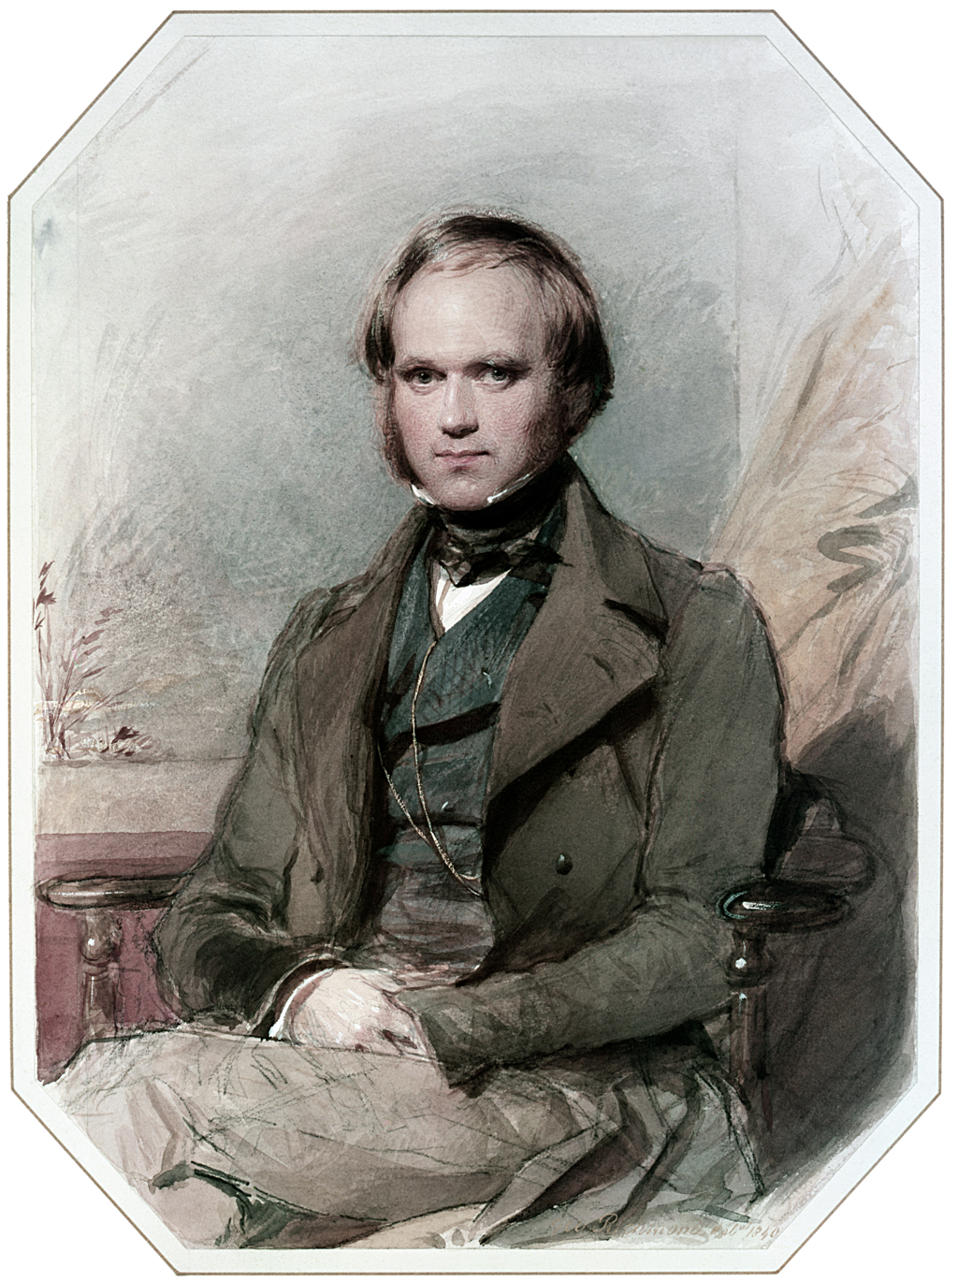
Darwin-Wedwood tree

Slide 3

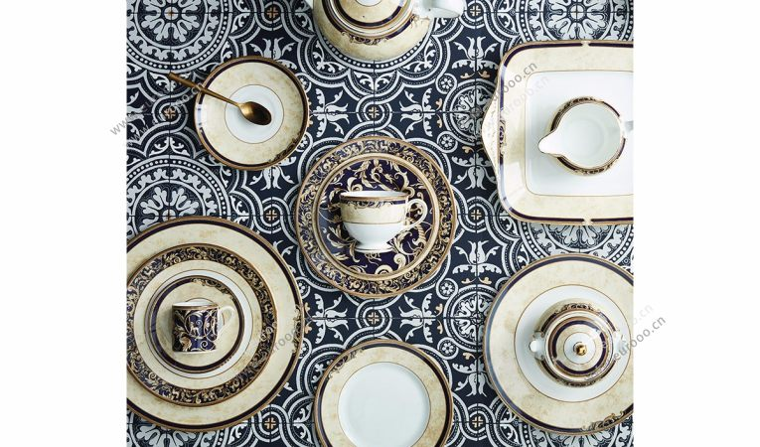
Wedgwood

Slide 4
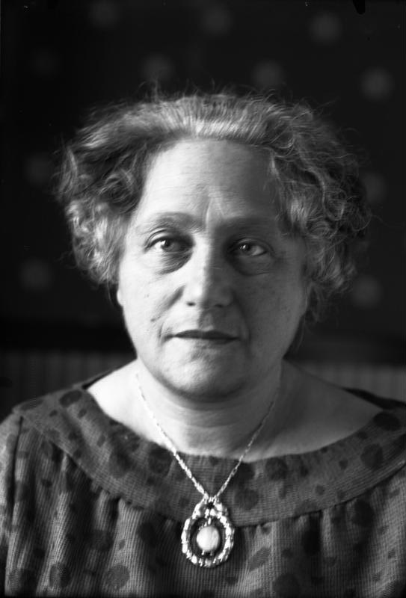
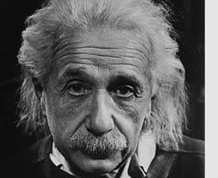
Kissing cousins

Slide 5
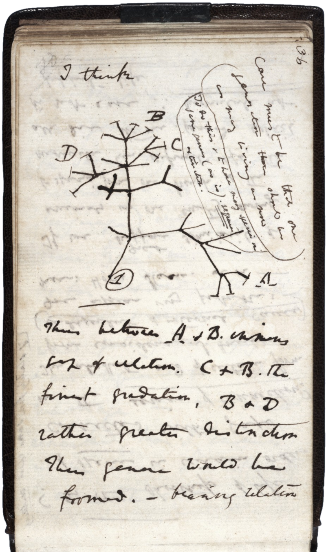
Darwin Tree

Slide 6
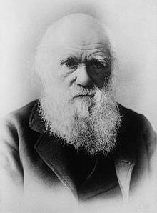
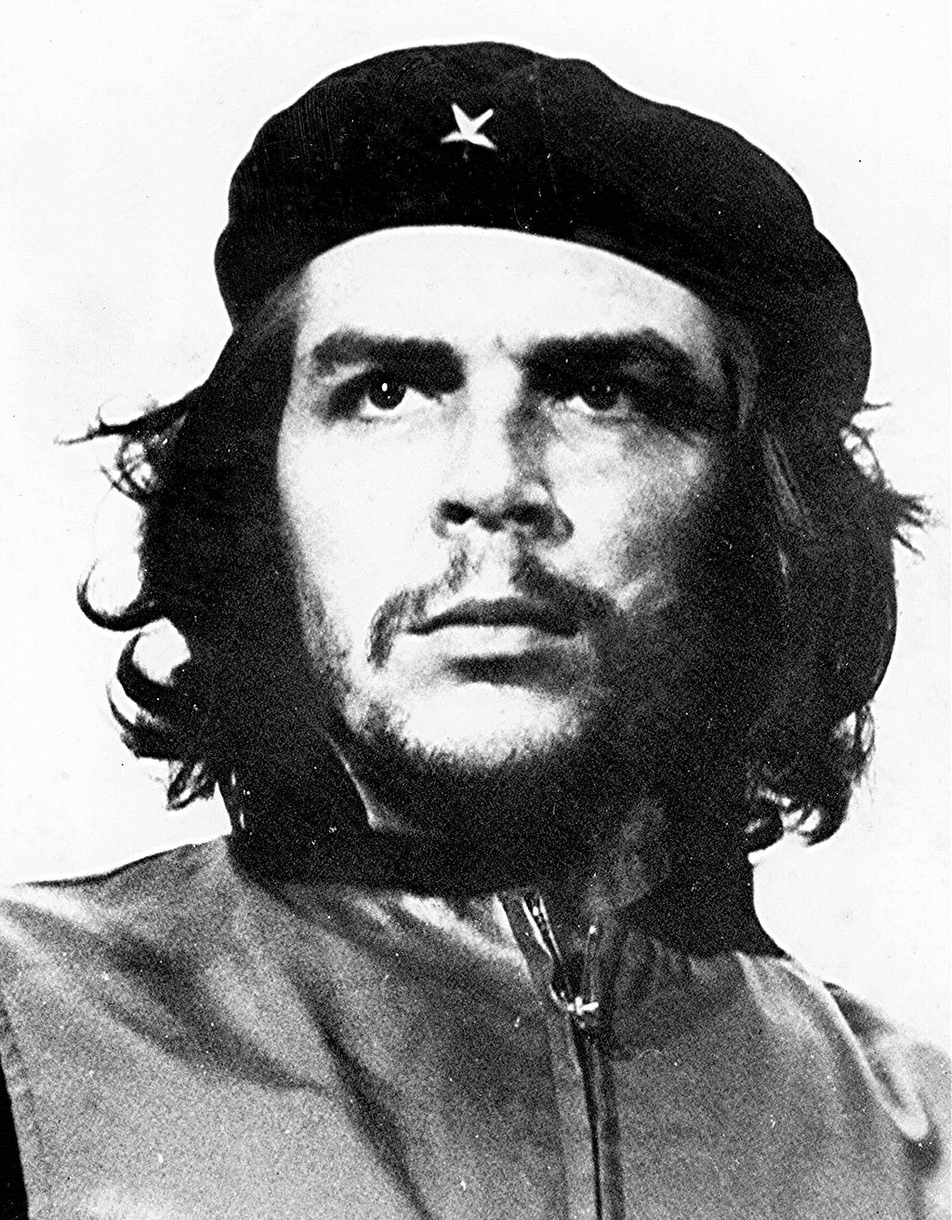
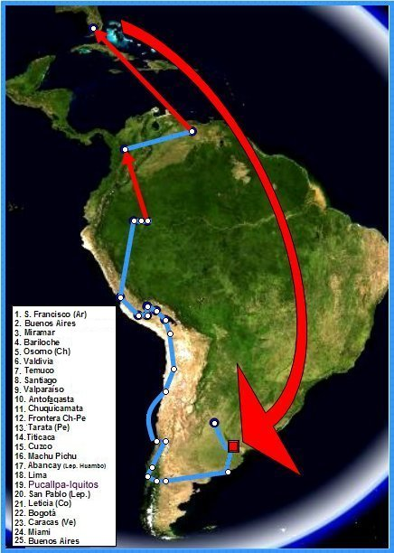
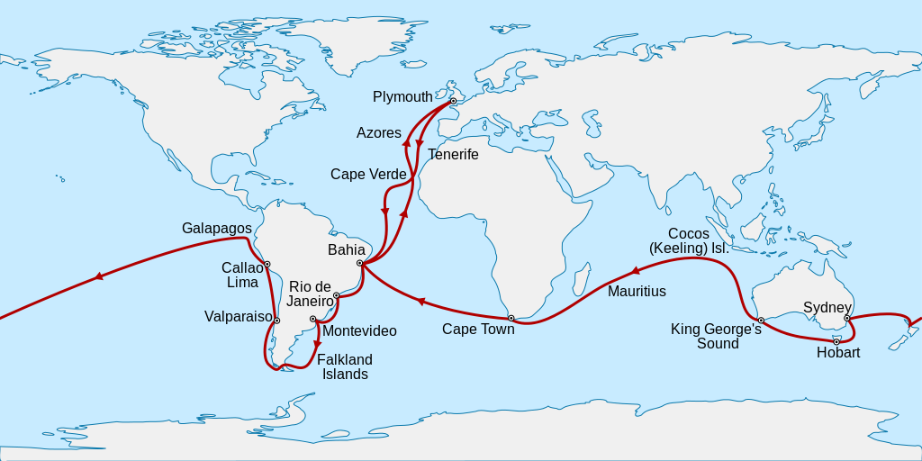
Beagle voyage
Evolution vs Revolution

Slide 7
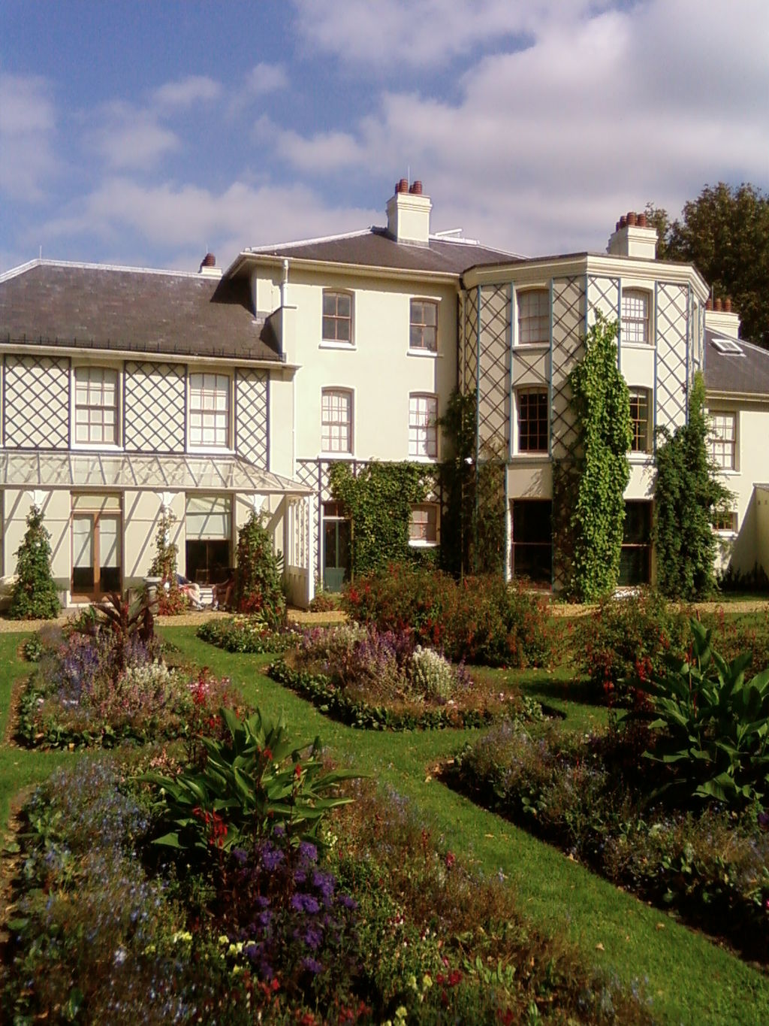
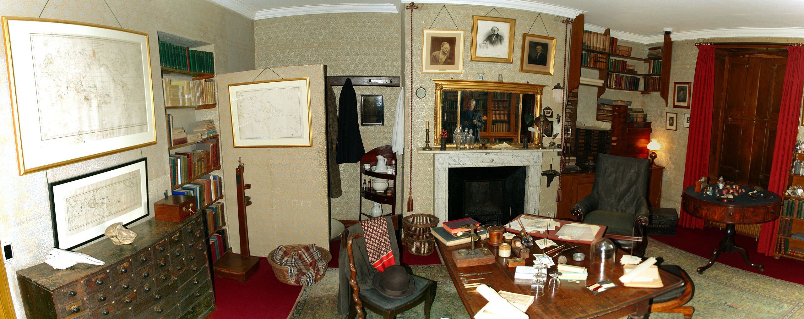
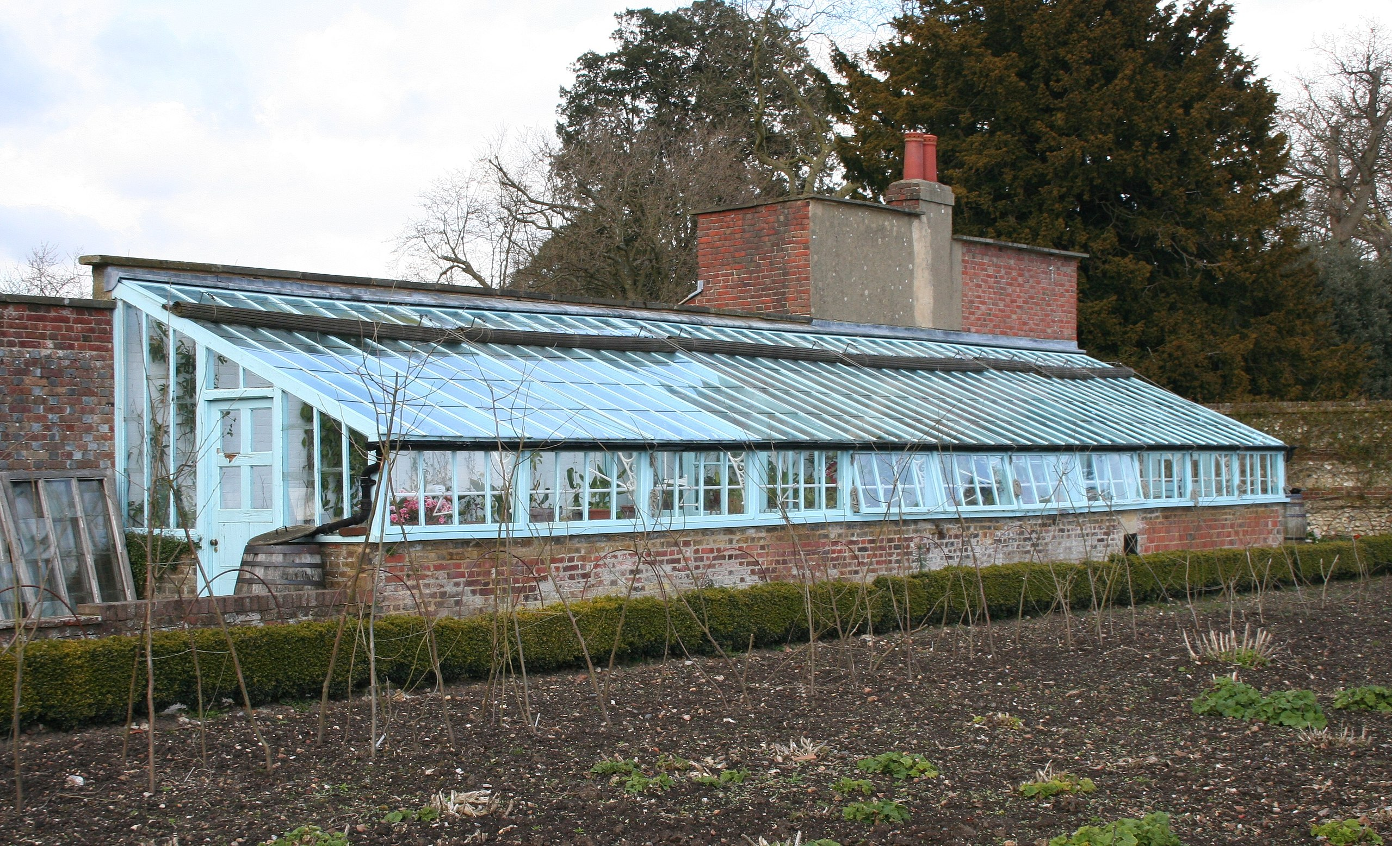
Darwin’s Lab:Down house

Slide 8
Darwin’s health problems…
Imperfect fossil records
Poor garden experiments…
Bleeding inheritance, his big trouble

Slide 9
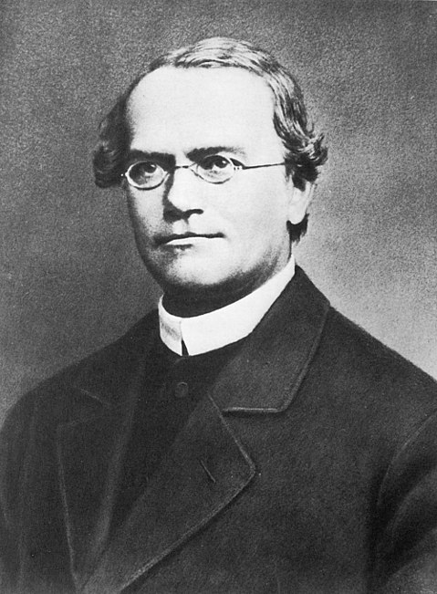
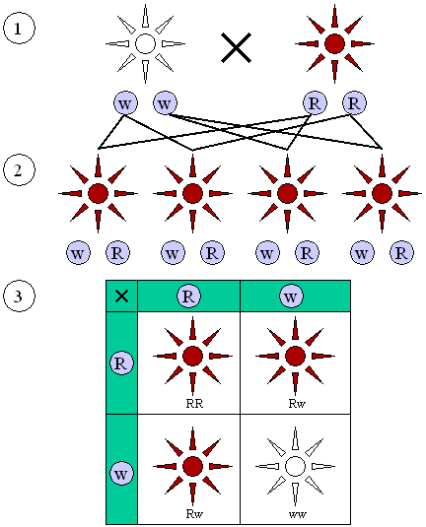
Mendel’s genetics

Slide 10
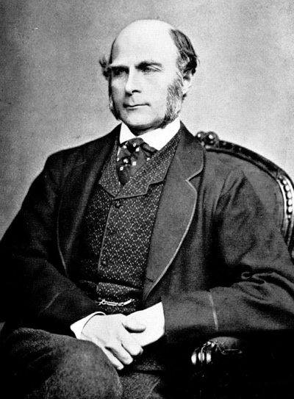
Francis Galton
Regression
Correlation
Eugenic
Nature versus nurture
Fingerprint

Slide 11
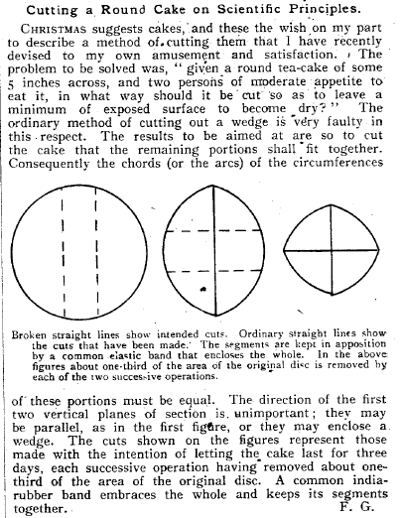
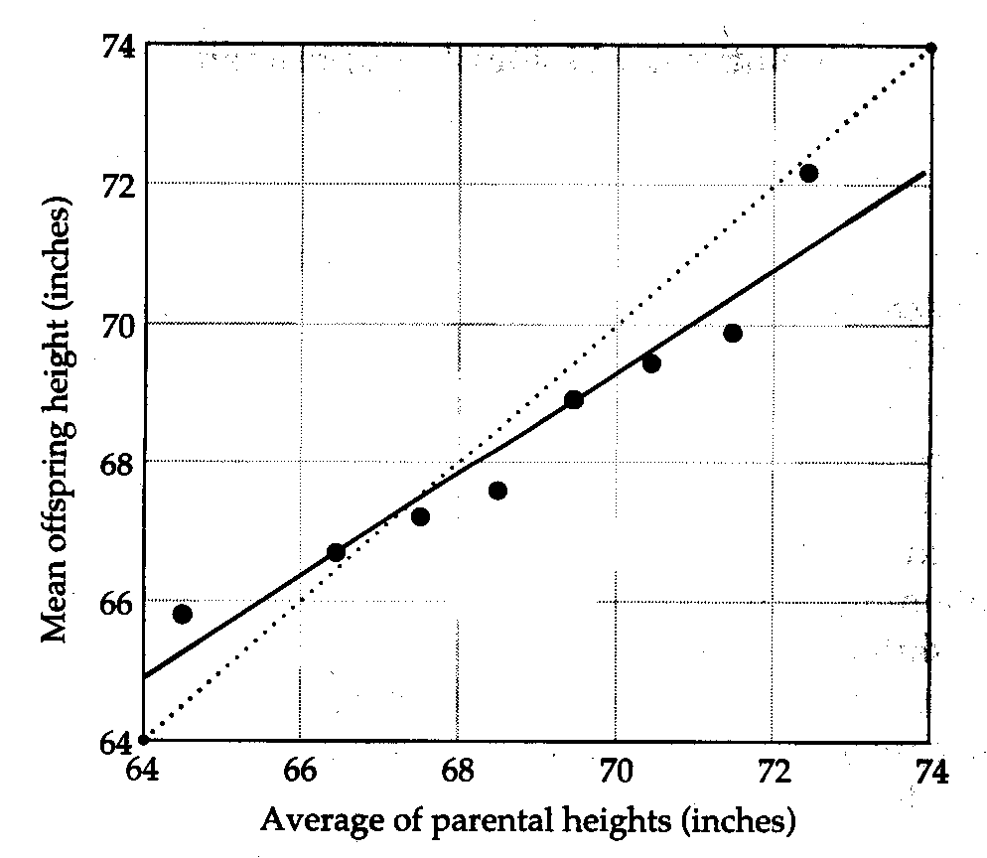
Polymath

Slide 12
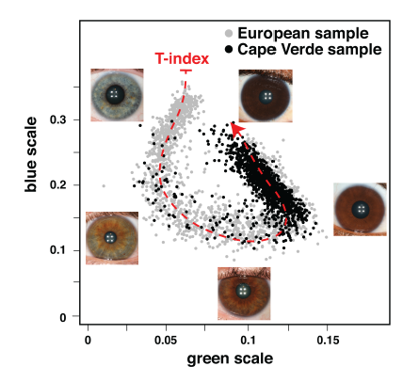
Eye color

Slide 13

Royal Geographical Society

Slide 14
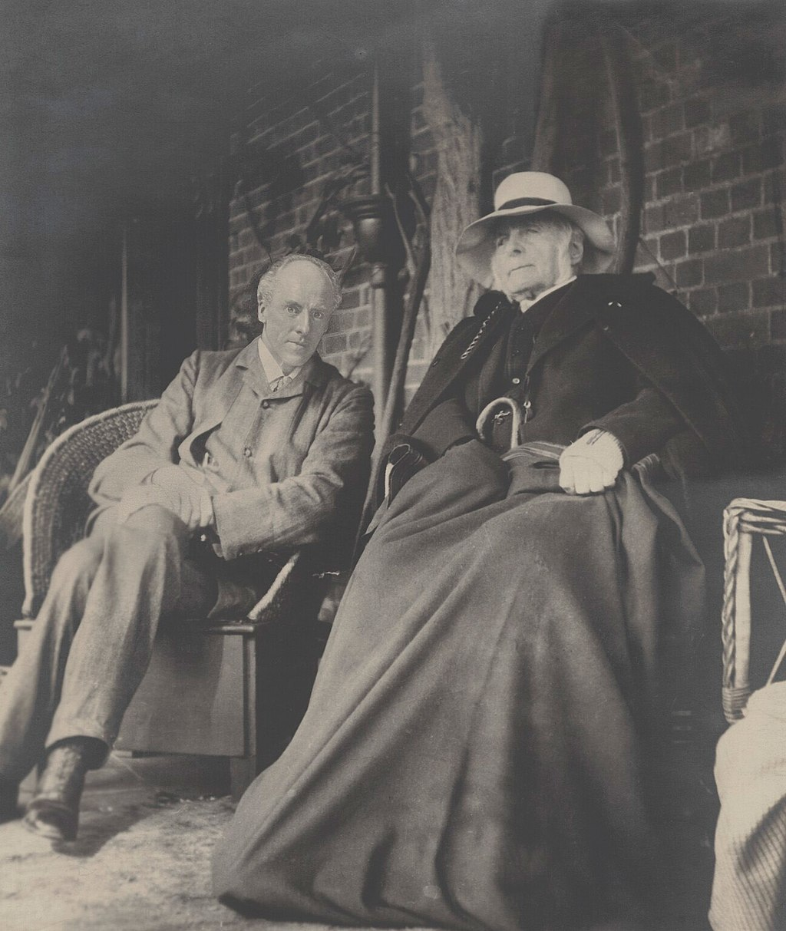
Karl Pearson

Slide 15
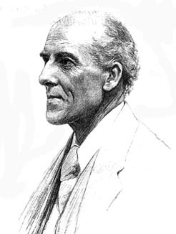
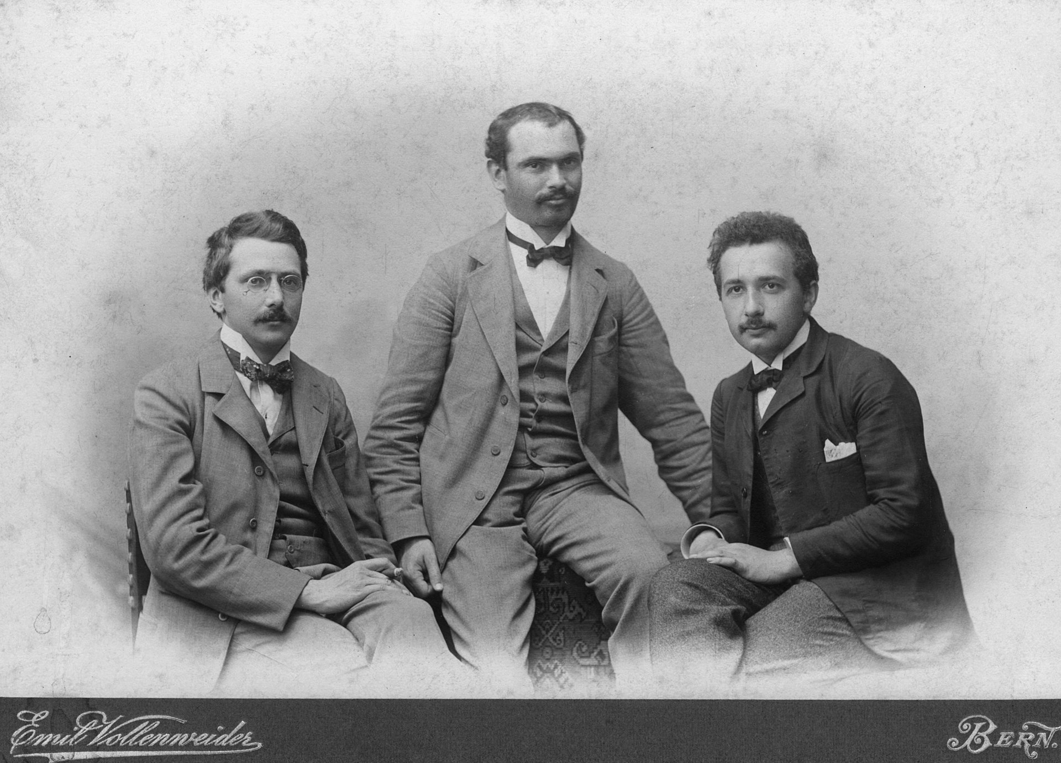
Karl Pearson
Chi-square test
Principal component analysis
Regression analysis
The Grammer of Science

Slide 16
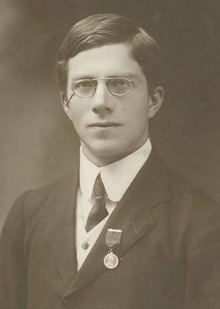
R A Fisher

Slide 17
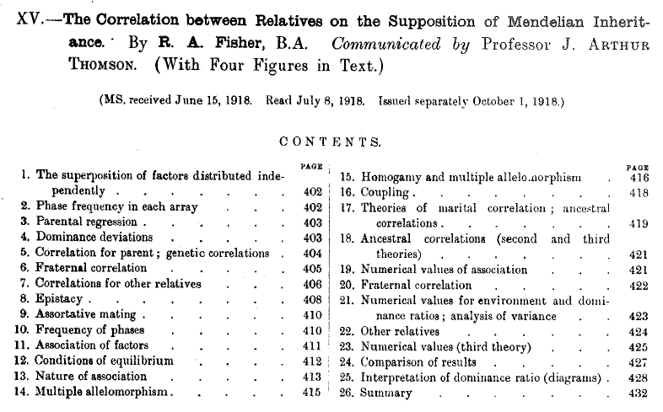

Slide 18
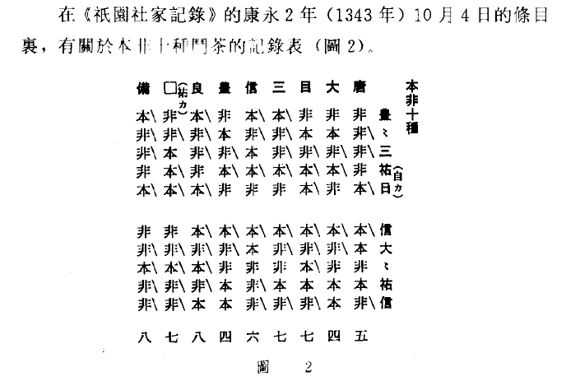

Slide 19
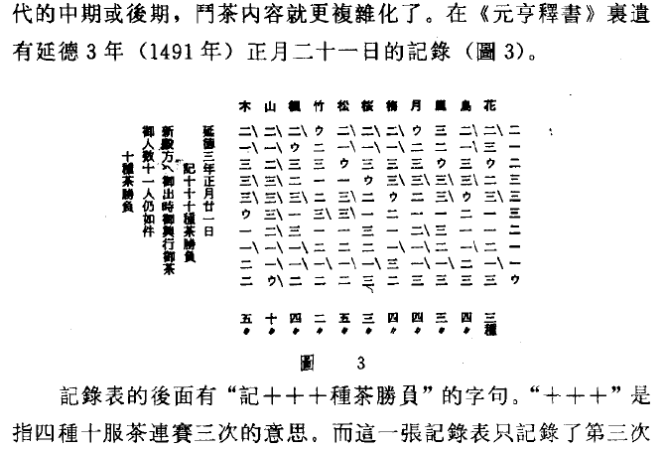

Slide 20
Three giants
R A Fisher (1890-1962)
Sewall Wright (1889-1988)
JBS Haldane (1892-1964)

